Slide 1
Introduction

Slide 2


One Minute Finance
Vision
Snapshot of the most important daily news in finance that affects you and your wallet
Mission
We are developing a blog to drive people and create a sense of community for financial discussions.
Expansion - One Minute Fashion, One Minute Beauty.

Slide 3

Snapshot

Slide 4
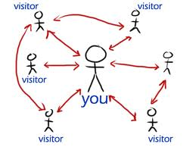
Concept of a Blog
A blog is journal published on the web consisting of chronological entries.
A blog creates a sense of community where people can connect, have discussions or gather information related to the person’s interest.

Slide 5
Marketing

Slide 6
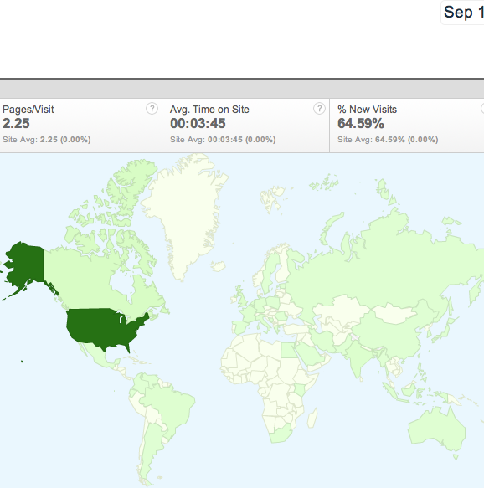
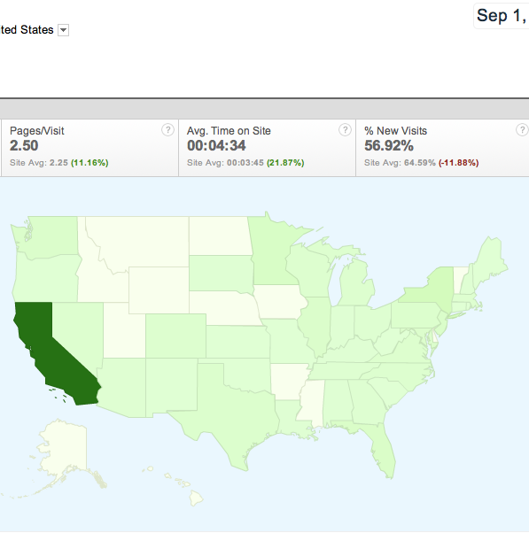
Market Assessment and Current Users
World
United States

Slide 7
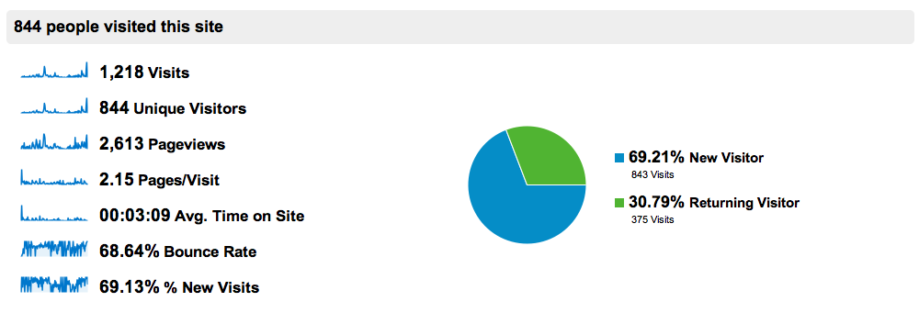
Analytics
October 1, 2011 – To Date

Slide 8
Macroeconomic Overview 2012
Southern California County Job Growth
Leaders - #1 High-Tech
#2 Tourism
#3 International Trade
#4 Entertainment
Laggards - #1 Construction
#2 State/Local Government Spending

Slide 9
US Economic Growth 2003-2012

Slide 10
Survey
Total: 200 people surveyed
Age: 18-39 - 68%
Sex: Female - 58%
Location: California – 67%
What stops you from reading financial news on a daily basis?
Not Enough Time - 56%
Not Interested in Finance - 25%
Further continuous analysis: Will use outside market research companies who will provide us with greater test population. (i.e Research Now)

Slide 11



Competitors

Slide 12

Laws , Regulations, Governance
LLC
Trademark and copyright protection
Online privacy laws
The CAN-SPAM Act
The FTC Guidelines for endorsements and testimonial
Libel

Slide 13
SWOT Analysis
Strengths:
Captures the most important recent daily financial news.
Provide a simple written or video summary of the most important financial news.
Weaknesses:
New start up blog.
Not many know about it.
Opportunities:
No other financial blog capture the most important financial daily news in a snapshot and keep it simple. Able to attract a broader demographic. (Women, People new to finance)
Threats:
Competitors may want to copy the concept of One Minute and create their own version.

Slide 14
SWOT Analysis
STRONG
Captures the most important recent daily financial news
WEAK
New start up blog.
THREATS
OPPORTUNITIES
Competitors may want to copy the concept of One Minute
capture the most important financial daily news in a snapshot

Slide 15

Internet and Social Networking
Social media websites such as Facebook, Twitter & LinkedIn will be utilized to build an online network for the blog.
One minute finance will also participate in threaded discussion on other financial blog.

Slide 16
Advertisement Methods
Pay per click (PPC) -- PPC is a type of sponsored online advertising that is used on a wide range of websites, including search engines, where the advertiser only pays if a web user clicks on their ad.
Pay per Action (PPA) -- Advertiser pays for each specific action. (Purchase, Form Submission)
Direct Blog Sponsorship -- The company pays a fee to the blog to be listed as a sponsor, similar to underwriting on public television.
Advertisement Banners
Notes:
Oneminutefinance.com’s valuable content on the websites that attracts AdSense advertisements, which pay out the most when they are clicked

Slide 17
Advertisement Banner Terms
Click Through Rate (CTR) -- The percentage of click through to banner views. A 1% CTR means that 1% of each 1000 banner views (or 10 visitors) have clicked through.
Banner views or impressions -- Refers to the number of times a banner has been viewed.

Slide 18
Promoting the blog
Attend business trade shows and include the blog information in a booth.
Include an announcement about the blog in a financial business newsletter.
Passing out business cards, which will include the blog, it’s address and email signature.
Attend Venture Capital events.
Get Involved in Social Media

Slide 19

Market Trend
Infographics are playing a bigger role in 2012
Mobile social networking is the fastest growing consumer application
Members get connected through our website for networking reason
Videos are responsible for 50% of all online activities
Interactive social media is getting stronger

Slide 20
Market Trends
Networking @Oneminute Finance
Mobile Social Media Networking
Infographics
2012
Video 50% online activities
Interactive Social Media

Slide 21
Operations

Slide 22
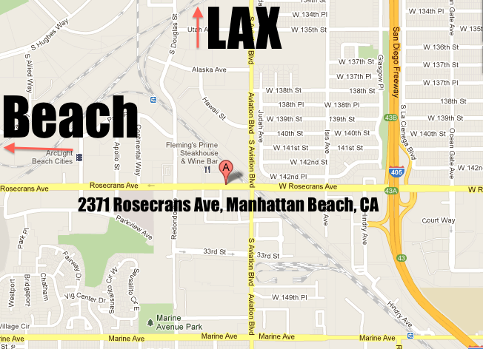
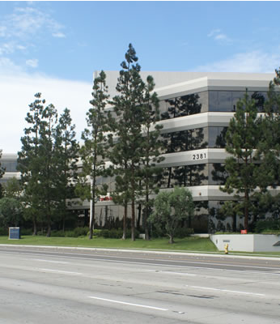
Location
Notes:
Location close to the beach and LAX and 405. Many companies in the same industry. Created Buzz and synergy.
On the 3rd year we are going to get an office.

Slide 23
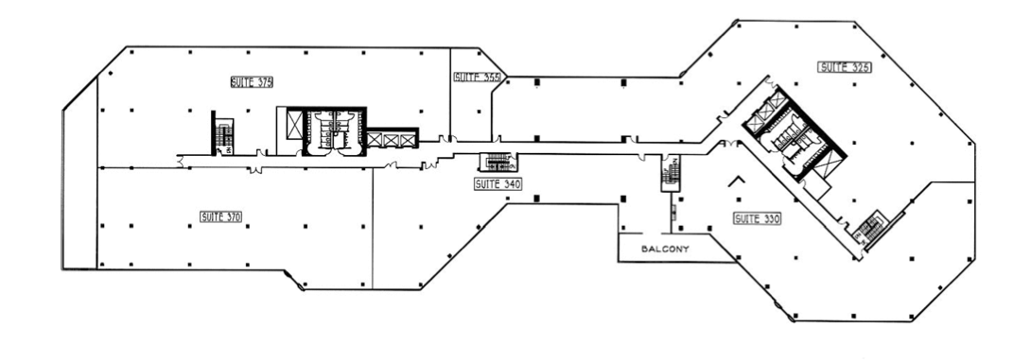
Floor Map
Suite 348
806 sq. ft.
$2.75/sq. ft.
Notes:
Comes with office equipment.

Slide 24
Operating Plan & Execution
Search
OneMinutify
Publish
Promote
Notes:
Search: Expert searches financial websites for most important/trendy financial news
Oneminutify : Expert simplifies and summarizes the news to be absorbed within one minute approx.
Publish: The news is published on website to enjoy
Promote: The news will be promoted through social media (Facebook, Twitter, Youtube)

Slide 25
Facilities and Equipment Plan

Slide 26
Risk Management
Regular/ Automatic updates
Anti-virus systems
Insurance
Crisis Phone Tree
Emergency Response Communication Plan
Safe passwords
Opportunities!!!

Slide 27
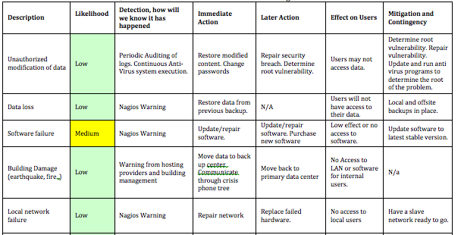
Risk Analysis
Nagios: IT infrastructure Monitoring

Slide 28




Management
Shahin Mohammadkhani Founder/CEO
Jessica Arabi Director of Marketing
Golbon Moridi Director of Operations
Isabelle Lee Director of Finance
Replication of Knowledge / Cross Training
Notes:
Profit sharing and performance management. As the company make the profits are devided 4 ways.
4 agreements – Be impeccable with your word, don’t take anything personally, always do your best, never made assumptions.

Slide 29






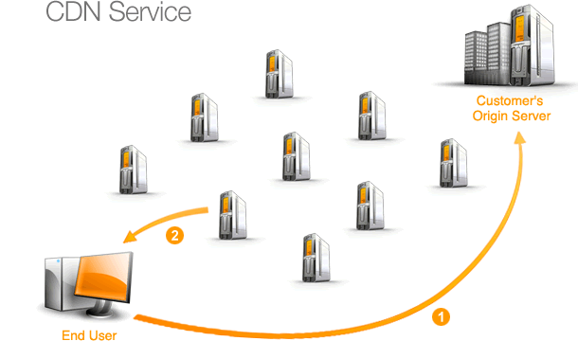



Information Technology

Slide 30
Finance

Slide 31

Start up Costs
Total Start up Cost :$13,270.00

Slide 32

Financing
Notes:
Venture Capital
30k with 10% equity return after 5 years and 5% yearly profit

Slide 33


Fist Year Operating Costs
Total Operating Costs (Year 1): $4950
Notes:
First year operating cost
Virtual office for year 1 and year 2
Total Depreciation expense 1200 Bank account's fee 180 Internet & Telephone 1920 Print 1650 Total Operating expense 4950

Slide 34
OPERATING EXPENSE
 | Year 1 | Year 2 | Year 3 | Year 4 | Year 5
General & Administrative expense
Salary expense | $ - | $ - | $ 48,000.00 | $ 48,000.00 | $ 96,000.00
Depreciation expense | $ 1,200.00 | $ 1,200.00 | $ 1,200.00 | $ 2,400.00 | $ 3,000.00
Employee Benefits | $ - | $ - | $ - | $ 9,600.00 | $ 9,600.00
Rent Expense |  |  | $ 26,598.00 | $ 26,598.00 | $ 26,598.00
Parking fee |  |  | $ 3,360.00 | $ 3,360.00 | $ 3,360.00
Bank account's fee | $ 180.00 | $ 180.00 | $ 180.00 | $ 180.00 | $ 180.00
Internet & Telephone | $ 1,920.00 | $ 1,920.00 | $ 1,920.00 | $ 1,920.00 | $ 1,920.00
IT infrasture monitoring |  | $ 595.00 | $ 595.00 | $ 595.00 | $ 595.00
License & Fee |  | $ 1,000.00 | $ 2,000.00 | $ 3,000.00 | $ 6,000.00
Office supplies | $ - | $ 600.00 | $ 600.00 | $ 1,200.00 | $ 1,800.00
Outside Contractor |  | $ 2,080.00 | $ 4,160.00 | $ 6,240.00 | $ 14,600.00
Utility Expense |  | $ 600.00 | $ 600.00 | $ 600.00 | $ 600.00
Web hostings |  | $ 100.00 | $ 100.00 | $ 100.00 | $ 100.00
Expenses for Software |  | $ 400.00 | $ 400.00 | $ 400.00 | $ 400.00
Marketing costs |  | $ 14,400.00 | $ 14,400.00 | $ 14,400.00 | $ 14,400.00
Total Operating expense | $ 4,950.00 | $ 23,075.00 | $ 104,113.00 | $ 118,593.00 | $ 179,153.00
Notes:
Year 3 Salary
Year 3 parking $70 , rent expense
Outside contractor

Slide 36
Revenue – Year 1
Assumptions
Based on 15% Monthly Traffic Growth
PPC: 1.5 % CTR
PPA : $10.00/Unit & 3% Successful Transaction
Notes:
The Adsense revenue estimate has factored in the industry average cpm (earning per thousand page impressions) for Technology websites while arriving at the Adsense income).
Compound Growth Rate:15% monthly growth (traffic)
Revenue (Google Adsense) CPC Model
Year 1 $12 daily
Year 2 $60 daily
Year 3 $300 daily
Year 4 $1500 daily
Year 5 $9000 daily
Once traffic meets certain point, the pay bracket
Sharebuilder CPA Model
$10 per acquisition

Slide 37
5 Years Sales Projections
Notes:
Year 1 $ 6,212.00 - 6.2 % increase from year 1 to 2
Year 2 $ 39,407.40 - 7.6 % increase from year 2 to 3
Year 3 $ 203,190.00 - 5.2 % increase from year 3 to 4
Year 4 $ 1,552,800.00 - 6.3 % increase from year 4 to 5
Year 5 9,636,600.00

Slide 38
First Year Earning Analysis
Retained earnings | Year 1 | Year 2 | Year 3 | Year 4 | Year 5
Ending balance | $ 1,262.00 | $ 17,594.40 | $ 116,671.40 | $ 1,550,878.40 | $ 11,008,325.40
Notes:
Total sales,
Taxe rate for whenver u earn income
Bottom - how much cash you can retain from the bank.
LLC fee
$250,000 to $499,999 the fee is $900
$500,000 to $999,999 the fee is $2,500
$1,000,000 to $4,999,999 the fee is $6,000
$5,000,000 and over the fee is $11,790
Income Tax
8.84%
or min $800
How much cash do you have after the first year!!! - have residual cash.

Slide 39
Summary of Balance Sheet
Notes:
Exponential growth is because as traffic grows the tiered payout becomes higher.
Assets are all cash.
Total Assets 39,262 56,403 156,455 1,585,320 10,911,591
T S H – Equity 39,199 53,955 139,757 1,376,109 9,555,247

Slide 40
BALANCE SHEET
Items | Year 1 | Year 2 | Year 3 | Year 4 | Year 5
Current assets
Cash and equivalents | 33,944 | 49,519 | 137,122 | 1,449,920 | 10,102,541
Receivable | 518 | 3,284 | 16,933 | 129,400 | 803,050
Total Current assets | 34,462 | 52,803 | 154,055 | 1,579,320 | 10,905,591
Non-current assets
Property, Plant, Equipment | 6,000 | 6,000 | 6,000 | 12,000 | 15,000
Accumulated Depreciation | (1,200) | (2,400) | (3,600) | (6,000) | (9,000)
Total Non-current assets | 4,800 | 3,600 | 2,400 | 6,000 | 6,000
TOTAL ASSETS | 39,262 | 56,403 | 156,455 | 1,585,320 | 10,911,591
Current liabilities
Account payable |  | 808 | 2,583 | 6,000 | 7,608
Income Tax payable |  | 800 | 8,758 | 132,784 | 847,828
Total current liabilities |  | 1,608 | 11,342 | 138,784 | 855,437
Long term liabilities | 63 | 840 | 5,356 | 70,427 | 500,908
Total Long term liabilities
Total Liability | 63 | 2,448 | 16,697 | 209,211 | 1,356,344
Shareholders' equity
Owners' Capital | 38,000 | 38,000 | 38,000 | 38,000 | 38,000
Retained earnings | 1,262 | 16,794 | 107,113 | 1,408,536 | 10,018,155
Dividend Paid | (63) | (840) | (5,356) | (70,427) | (500,908)
Total shareholders' equity | 39,199 | 53,955 | 139,757 | 1,376,109 | 9,555,247
TOTAL LIABILITIES AND SHAREHOLDERS' EQUITY | 39,262 | 56,403 | 156,455 | 1,585,320 | 10,911,591

Slide 41

STATEMENT OF CASH FLOW
Items | Year 1 | Year 2 | Year 3 | Year 4 | Year 5
Beginning balance of cash |  | 33,944 | 49,519 | 137,122 | 1,449,920
Ending balance of cash | 33,944 | 49,519 | 137,122 | 1,449,920 | 10,102,541
Notes:
All net cashflow 33,944 15,574 87,603 1,312,798 8,652,621

Slide 42
STATEMENT OF CASH FLOW
Items | Year 1 | Year 2 | Year 3 | Year 4 | Year 5
Cash flow from operating activities
Net income or loss | 1,262 | 15,532 | 90,319 | 1,301,423 | 8,609,619
Depreciation and Amortization | 1,200 | 1,200 | 1,200 | 2,400 | 3,000
Changes in working capital
Changes in receivable | (518) | (2,766) | (13,649) | (112,468) | (673,650)
Changes in payable | 63 | 2,385 | 14,249 | 192,513 | 1,147,134
Net cash flow from operating activities | 2,007 | 16,351 | 92,119 | 1,383,869 | 9,086,102
Cash flow from investing activities
Purchase of PPE | (6,000) |  |  | (6,000) | (3,000)
Payment to deposits |  | - | - | - | -
Net cash flow from investing activities | (6,000) | - | - | (6,000) | (3,000)
Cashflow from financing activities
Paid dividend | (63) | (777) | (4,516) | (65,911) | (430,481)
Net cashflow from financing activities | 37,937 | (777) | (4,516) | (65,071) | (430,481)
All net cashflow | 33,944 | 15,574 | 87,603 | 1,312,798 | 8,652,621
Beginning balance of cash |  | 33,944 | 49,519 | 137,122 | 1,449,920
Ending balance of cash | 33,944 | 49,519 | 137,122 | 1,449,920 | 10,102,541
Notes:
Depreciation – computer

Slide 43
Probability and Liquidity Ratios
Notes:
ROI Year 4 104 %
Debt to Equity less than 20% which is good

Slide 44

Exit Strategy
Planning on getting acquired where we still remain on advisory board.
Sell for 15 million
Notes:
Pay off investors and get acquired.
22 million cost for acquired
If staff does not want to stay they can take their share and leave.
Total Value of Operation: $8,174,218
We used FCFF Valuation method
FCFF , WACC (6.5 %)

